Slide 1

Overview of UNIX/Linux Operating System
Module 1: GETTING STARTED & NAVIGATING THE SYSTEM

Slide 2
INDEX
What is an Operating System?
What is Unix?
History of UNIX Operating System
Linux Operating System
Features of Linux Operating System
Structure of LINUX Operating System.
Kernel in LINUX.
Shell in LINUX.
Types of Shell
Distributions of Linux

Slide 3
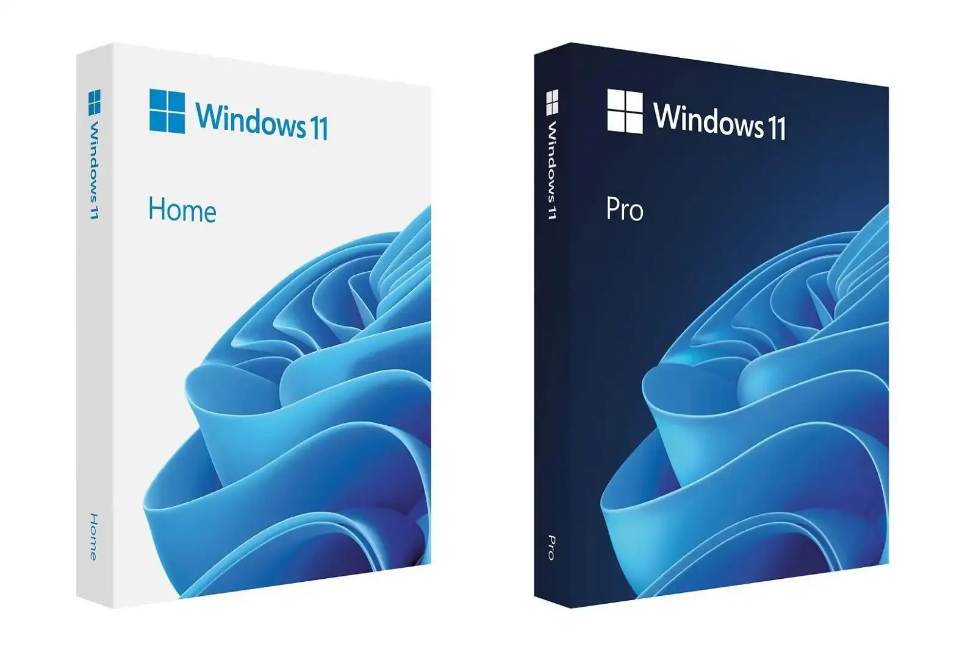
What is an Operating System?
An operating system or OS is software installed on a computer’s hard drive that enables the computer hardware to communicate and operate with the computer software.
In normal word, we can say that an operating system is a messenger which helps the user to communicate with the hardware.
This picture shows latest Microsoft Windows 11 in its
original packaging.

Slide 4
What is Unix?
UNIX is a multi-user, multitasking operating system (OS) that was developed at AT&T Bell Labs in the late 1960s. It was designed to be used exclusively by programmers and became a leading operating system for workstations because of its portability, flexibility and power.
UNIX systems also have a graphical user interface (GUI) similar to Microsoft Windows which provides an easy to use environment
The UNIX operating system is made up of three parts:
  The Kernel
  The Shell
  The Programs

Slide 5
History of UNIX Operating System.
The UNIX operating system was created in 1969 at by Ken Thompson, Dennis Ritchie, and a team of researchers looking for a simpler, portable alternative to the bulky Multics project.
The history of UNIX traces its evolution from a simple research project at Bell Labs to one of the most influential operating systems in the world.
  Origins and PDP-7 (1969)
  Rewriting in C and Portability (1973)
  Academic Expansion and Commercialization (1970s – 1980s)
  Legacy and Modern Influence (1990s – Present)

Slide 6
  Origins and PDP-7 (1969)
Multics Failure: Bell Labs pulled out of the overly complex Multics experimental time-sharing project in 1969.
The First Version: Ken Thompson used an idle PDP-7 minicomputer to write a stripped-down file system and kernel.
The Name: Brian Kernighan coined the name "UNIX" as a pun on Multics (Uniplexed Information and Computing Service).

Slide 7
  Rewriting in C and Portability (1973)
Assembly to C: Dennis Ritchie created the C programming language, and in 1973, Thompson and Ritchie rewrote the Unix kernel in C.
Hardware Independence: This rewrite made Unix portable across completely different computer hardware architectures rather than being locked to one machine.
The Name: Brian Kernighan coined the name "UNIX" as a pun on Multics (Uniplexed Information and Computing Service).

Slide 8
  Academic Expansion and Commercialization (1970s – 1980s)
BSD Fork: Ken Thompson taught Unix at UC Berkeley, leading to the creation of the Berkeley Software Distribution (BSD) branch.
System V: AT&T released commercial versions like UNIX System V, establishing two major rival families (BSD and System V).
Commercial Variants: Tech giants built proprietary versions including Solaris (Sun), HP-UX (HP), and AIX (IBM).

Slide 9
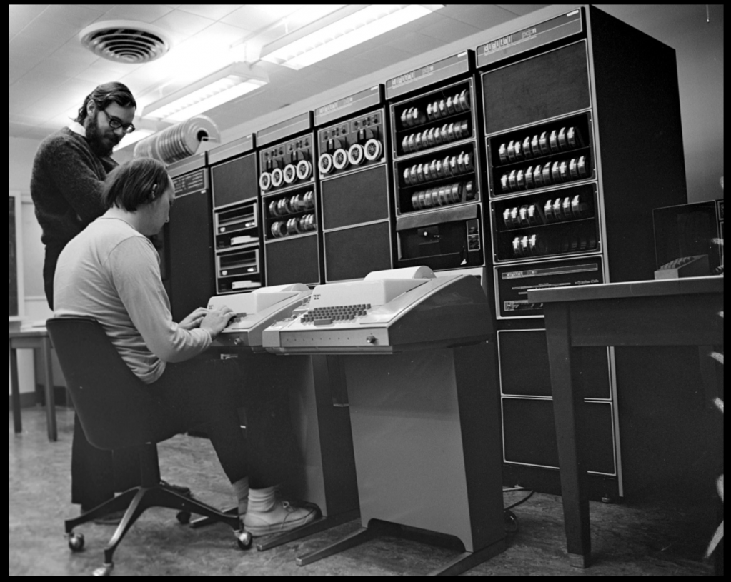
  Legacy and Modern Influence (1990s – Present)
Birth of Linux: Frustrated by proprietary licensing, Linus Torvalds created Linux in 1991 as a free, Unix-like alternative.
Modern OS Foundation: Unix design principles directly shape modern operating systems like macOS, iOS, Android, and various Linux distributions.
It is a picture of Bell Labs ( KEN THOMPSON is sitting on the chair
and DENNIS RITCHIE is standing next to Ken ).

Slide 10
Linux Operating System
Linux is a free, open-source operating system that manages computer hardware and software.
It was developed by Linus Torvalds in 1991, Linux officially transitioned to a true open-source model in 1992. The transition occurred when Linus Torvalds changed the project's legal license, which transformed it from a restrictive student hobby into a globally collaborative phenomenon.
Now-a-days from smartphones to cars, supercomputers and home appliances, home desktops to enterprise servers, the Linux OS is everywhere.

Slide 11
Features of Linux Operating System
Open Source: The source code is freely available to everyone. You can view, modify, and distribute it.
Security: Linux is very secure. It uses user privilege controls, password protection, and encrypted files. It rarely gets viruses compared to other systems.
Multi-user: Multiple users can use the same system at the same time. They can run their own programs without disturbing each other.
Multitasking: Linux can run many programs at the same time without slowing down.
Portability: Linux works on many different hardware devices. You can run it on small computers, large servers, and mobile phones. Security
Customizability: You can change almost everything in Linux. You can pick different desktop looks, themes, and system tools.
Stability: Linux rarely crashes. It can run for years without needing a restart. This makes it great for web servers.
Command Line and GUI: Linux offers a powerful text command line for experts. It also offers easy-to-use graphic desktop screens for regular users.

Slide 12
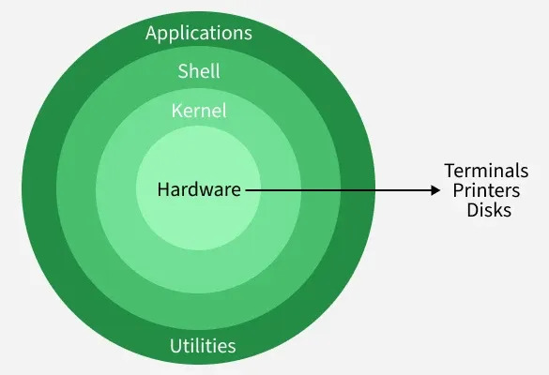
Structure of Linux Operating System
The Linux system basically works on 4 layers.
Hardware – Hardware consists of all physical devices attached to System. For example: Hard disk drive, RAM, Motherboard, CPU etc.
Kernel – Kernel is the core component for
any (Linux) operating system which directly
interacts with the hardware.
Shell – Shell is the interface which takes
input from Users and sends instructions to the Kernel.
Applications - These are the utility programs which
runs on Shell.
System Utilities - System Utilities are built-in tools used for system management, configuration, and maintenance.

Slide 13
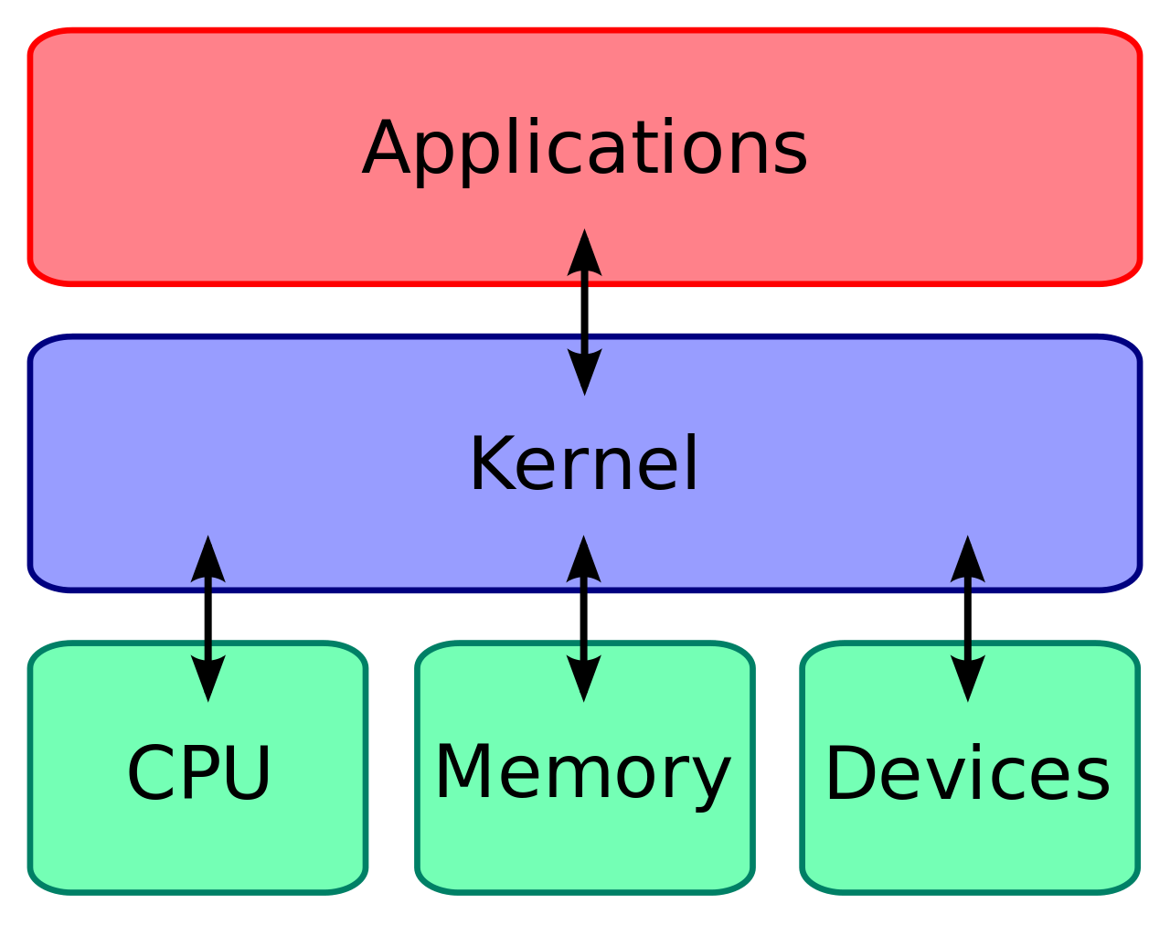
Kernel in Linux
The Linux kernel is the absolute core component of the Linux operating system. It acts as a critical bridge and translator between the computer's physical hardware and the software applications running on it.

Slide 14
Shell in Linux
In Linux, a shell is a command-line interpreter that acts as an interface between the user and the operating system kernel.
The Core Hierarchy
  Terminal: The window or text-based program where you type (e.g., GNOME Terminal).
  Shell: The program running inside the terminal that reads, interprets, and manages your commands.
  Kernel: The core software that directly interacts with your computer's physical hardware.

Slide 15
Types of Shell
Bourne shell (sh)
Korn shell (ksh)
Bourne Again shell (bash)
POSIX shell (sh)
C shell (csh)

Slide 16
Distributions of Linux
Ubuntu
Debian
Linux Mint
Red Hat Enterprise Linux
Cent OS
Fedora
KALI Linux
Arch Linux
OpenSUSE

